Slide 1
line
A straight path that extends
in both directions without end; marked with an arrowhead at
each end.

Slide 2
line segment
A piece of a line that has
two endpoints.

Slide 3
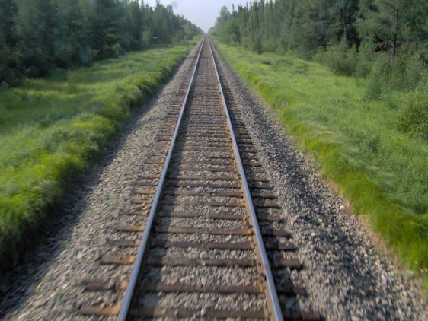
parallel lines
Two (or more) lines that run the same distance apart at every point and will never intersect.
ll
para el
lines

Slide 4
ray
A line with one end point that extends non-stop in the
opposite direction.

Slide 5
angle
A shape formed by two rays that share an endpoint.

Slide 6
vertex
plural: vertices
The point where:
two or more rays share an endpoint.
the edges of a solid figure meet.
The point at the top of a cone.

Slide 7
intersecting lines
Two or more lines that
meet or cross at a point.

Slide 8
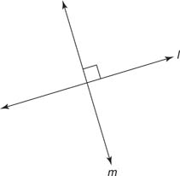
perpendicular lines
Two lines that intersect
and form right angles.

Slide 9
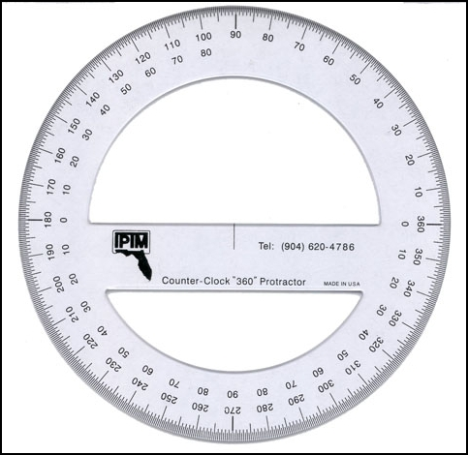
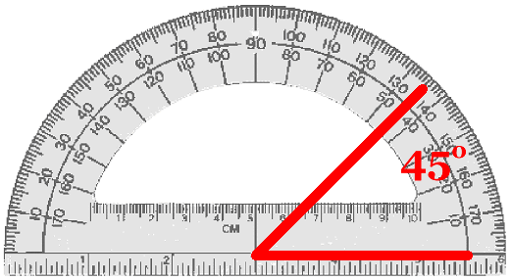
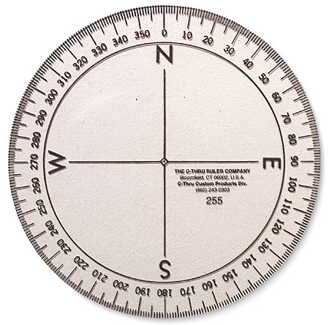
protractor
Tool used to measure angles.

Slide 10
A full circle rotation is equal to 360° (degrees)
When divided into four equal sections, each section is worth 90°
1 rotation = 90°
2 rotations = 180°
3 rotations = 270°
4 rotations = 360°
360°
90°
90°
90°
270°
90°
90°
90°
90°
90°
180°

Slide 11
right angle
An angle measuring 90 degrees.

Slide 12
acute angle
An angle that measures
LESS than 90 degrees.

Slide 13
obtuse angle
An angle that measures
MORE than 90 degrees.

Slide 14
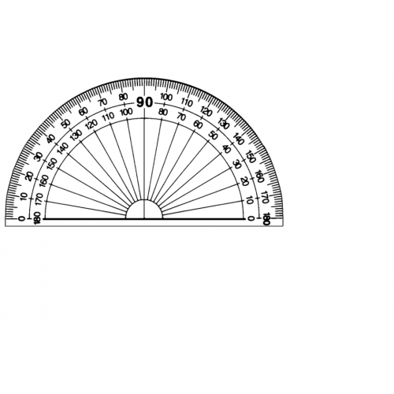
straight angle
An angle that measures
180 degrees.

Slide 15
line
A straight path that extends
in both directions without end; marked with an arrowhead at
each end.

Slide 16
line segment
A piece of a line that has
two endpoints.

Slide 17
parallel lines
Two (or more) lines that run the same distance apart at every point and will never intersect.
ll
para el
lines

Slide 18
ray
A line with one end point that extends non-stop in the
opposite direction.

Slide 19
angle
A shape formed by two rays that share an endpoint.

Slide 20
vertex
plural: vertices
The point where:
two or more rays share an endpoint.
the edges of a solid figure meet.
The point at the top of a cone.

Slide 21
intersecting lines
Two or more lines that
meet or cross at a point.

Slide 22
perpendicular lines
Two lines that intersect
and form right angles.

Slide 23
protractor
Tool used to measure angles.

Slide 24
A full circle rotation is equal to 360° (degrees)
When divided into four equal sections, each section is worth 90°
1 rotation = 90°
2 rotations = 180°
3 rotations = 270°
4 rotations = 360°
360°
90°
90°
90°
270°
90°
90°
90°
90°
90°
180°

Slide 25
right angle
An angle measuring 90 degrees.

Slide 26
acute angle
An angle that measures
LESS than 90 degrees.

Slide 27
obtuse angle
An angle that measures
MORE than 90 degrees.

Slide 28
straight angle
An angle that measures
180 degrees.

Slide 29
line
A straight path that extends
in both directions without end; marked with an arrowhead at
each end.

Slide 30
line segment
A piece of a line that has
two endpoints.

Slide 31
parallel lines
Two (or more) lines that run the same distance apart at every point and will never intersect.
ll
para el
lines

Slide 32
ray
A line with one end point that extends non-stop in the
opposite direction.

Slide 33
angle
A shape formed by two rays that share an endpoint.

Slide 34
vertex
plural: vertices
The point where:
two or more rays share an endpoint.
the edges of a solid figure meet.
The point at the top of a cone.

Slide 35
intersecting lines
Two or more lines that
meet or cross at a point.

Slide 36
perpendicular lines
Two lines that intersect
and form right angles.

Slide 37
protractor
Tool used to measure angles.

Slide 38
A full circle rotation is equal to 360° (degrees)
When divided into four equal sections, each section is worth 90°
1 rotation = 90°
2 rotations = 180°
3 rotations = 270°
4 rotations = 360°
360°
90°
90°
90°
270°
90°
90°
90°
90°
90°
180°

Slide 39
right angle
An angle measuring 90 degrees.

Slide 40
acute angle
An angle that measures
LESS than 90 degrees.

Slide 41
obtuse angle
An angle that measures
MORE than 90 degrees.

Slide 42
straight angle
An angle that measures
180 degrees.

Slide 43
line
A straight path that extends
in both directions without end; marked with an arrowhead at
each end.

Slide 44
line segment
A piece of a line that has
two endpoints.

Slide 45
parallel lines
Two (or more) lines that run the same distance apart at every point and will never intersect.
ll
para el
lines

Slide 46
ray
A line with one end point that extends non-stop in the
opposite direction.

Slide 47
angle
A shape formed by two rays that share an endpoint.

Slide 48
vertex
plural: vertices
The point where:
two or more rays share an endpoint.
the edges of a solid figure meet.
The point at the top of a cone.

Slide 49
intersecting lines
Two or more lines that
meet or cross at a point.

Slide 50
perpendicular lines
Two lines that intersect
and form right angles.

Slide 51
protractor
Tool used to measure angles.

Slide 52
A full circle rotation is equal to 360° (degrees)
When divided into four equal sections, each section is worth 90°
1 rotation = 90°
2 rotations = 180°
3 rotations = 270°
4 rotations = 360°
360°
90°
90°
90°
270°
90°
90°
90°
90°
90°
180°

Slide 53
right angle
An angle measuring 90 degrees.

Slide 54
acute angle
An angle that measures
LESS than 90 degrees.

Slide 55
obtuse angle
An angle that measures
MORE than 90 degrees.

Slide 56
straight angle
An angle that measures
180 degrees.

Slide 57
line
A straight path that extends
in both directions without end; marked with an arrowhead at
each end.

Slide 58
line segment
A piece of a line that has
two endpoints.

Slide 59
parallel lines
Two (or more) lines that run the same distance apart at every point and will never intersect.
ll
para el
lines

Slide 60
ray
A line with one end point that extends non-stop in the
opposite direction.

Slide 61
angle
A shape formed by two rays that share an endpoint.

Slide 62
vertex
plural: vertices
The point where:
two or more rays share an endpoint.
the edges of a solid figure meet.
The point at the top of a cone.

Slide 63
intersecting lines
Two or more lines that
meet or cross at a point.

Slide 64
perpendicular lines
Two lines that intersect
and form right angles.

Slide 65
protractor
Tool used to measure angles.

Slide 66
A full circle rotation is equal to 360° (degrees)
When divided into four equal sections, each section is worth 90°
1 rotation = 90°
2 rotations = 180°
3 rotations = 270°
4 rotations = 360°
360°
90°
90°
90°
270°
90°
90°
90°
90°
90°
180°

Slide 67
right angle
An angle measuring 90 degrees.

Slide 68
acute angle
An angle that measures
LESS than 90 degrees.

Slide 69
obtuse angle
An angle that measures
MORE than 90 degrees.

Slide 70
straight angle
An angle that measures
180 degrees.

Slide 71
line
A straight path that extends
in both directions without end; marked with an arrowhead at
each end.

Slide 72
line segment
A piece of a line that has
two endpoints.

Slide 73
parallel lines
Two (or more) lines that run the same distance apart at every point and will never intersect.
ll
para el
lines

Slide 74
ray
A line with one end point that extends non-stop in the
opposite direction.

Slide 75
angle
A shape formed by two rays that share an endpoint.

Slide 76
vertex
plural: vertices
The point where:
two or more rays share an endpoint.
the edges of a solid figure meet.
The point at the top of a cone.

Slide 77
intersecting lines
Two or more lines that
meet or cross at a point.

Slide 78
perpendicular lines
Two lines that intersect
and form right angles.

Slide 79
protractor
Tool used to measure angles.

Slide 80
A full circle rotation is equal to 360° (degrees)
When divided into four equal sections, each section is worth 90°
1 rotation = 90°
2 rotations = 180°
3 rotations = 270°
4 rotations = 360°
360°
90°
90°
90°
270°
90°
90°
90°
90°
90°
180°

Slide 81
right angle
An angle measuring 90 degrees.

Slide 82
acute angle
An angle that measures
LESS than 90 degrees.

Slide 83
obtuse angle
An angle that measures
MORE than 90 degrees.

Slide 84
straight angle
An angle that measures
180 degrees.

Slide 85
line
A straight path that extends
in both directions without end; marked with an arrowhead at
each end.

Slide 86
line segment
A piece of a line that has
two endpoints.

Slide 87
parallel lines
Two (or more) lines that run the same distance apart at every point and will never intersect.
ll
para el
lines

Slide 88
ray
A line with one end point that extends non-stop in the
opposite direction.

Slide 89
angle
A shape formed by two rays that share an endpoint.

Slide 90
vertex
plural: vertices
The point where:
two or more rays share an endpoint.
the edges of a solid figure meet.
The point at the top of a cone.

Slide 91
intersecting lines
Two or more lines that
meet or cross at a point.

Slide 92
perpendicular lines
Two lines that intersect
and form right angles.

Slide 93
protractor
Tool used to measure angles.

Slide 94
A full circle rotation is equal to 360° (degrees)
When divided into four equal sections, each section is worth 90°
1 rotation = 90°
2 rotations = 180°
3 rotations = 270°
4 rotations = 360°
360°
90°
90°
90°
270°
90°
90°
90°
90°
90°
180°

Slide 95
right angle
An angle measuring 90 degrees.

Slide 96
acute angle
An angle that measures
LESS than 90 degrees.

Slide 97
obtuse angle
An angle that measures
MORE than 90 degrees.

Slide 98
straight angle
An angle that measures
180 degrees.

Slide 99
line
A straight path that extends
in both directions without end; marked with an arrowhead at
each end.

Slide 100
line segment
A piece of a line that has
two endpoints.

Slide 101
parallel lines
Two (or more) lines that run the same distance apart at every point and will never intersect.
ll
para el
lines

Slide 102
ray
A line with one end point that extends non-stop in the
opposite direction.

Slide 103
angle
A shape formed by two rays that share an endpoint.

Slide 104
vertex
plural: vertices
The point where:
two or more rays share an endpoint.
the edges of a solid figure meet.
The point at the top of a cone.

Slide 105
intersecting lines
Two or more lines that
meet or cross at a point.

Slide 106
perpendicular lines
Two lines that intersect
and form right angles.

Slide 107
protractor
Tool used to measure angles.

Slide 108
A full circle rotation is equal to 360° (degrees)
When divided into four equal sections, each section is worth 90°
1 rotation = 90°
2 rotations = 180°
3 rotations = 270°
4 rotations = 360°
360°
90°
90°
90°
270°
90°
90°
90°
90°
90°
180°

Slide 109
right angle
An angle measuring 90 degrees.

Slide 110
acute angle
An angle that measures
LESS than 90 degrees.

Slide 111
obtuse angle
An angle that measures
MORE than 90 degrees.

Slide 112
straight angle
An angle that measures
180 degrees.

Slide 113
line
A straight path that extends
in both directions without end; marked with an arrowhead at
each end.

Slide 114
line segment
A piece of a line that has
two endpoints.

Slide 115
parallel lines
Two (or more) lines that run the same distance apart at every point and will never intersect.
ll
para el
lines

Slide 116
ray
A line with one end point that extends non-stop in the
opposite direction.

Slide 117
angle
A shape formed by two rays that share an endpoint.

Slide 118
vertex
plural: vertices
The point where:
two or more rays share an endpoint.
the edges of a solid figure meet.
The point at the top of a cone.

Slide 119
intersecting lines
Two or more lines that
meet or cross at a point.

Slide 120
perpendicular lines
Two lines that intersect
and form right angles.

Slide 121
protractor
Tool used to measure angles.

Slide 122
A full circle rotation is equal to 360° (degrees)
When divided into four equal sections, each section is worth 90°
1 rotation = 90°
2 rotations = 180°
3 rotations = 270°
4 rotations = 360°
360°
90°
90°
90°
270°
90°
90°
90°
90°
90°
180°

Slide 123
right angle
An angle measuring 90 degrees.

Slide 124
acute angle
An angle that measures
LESS than 90 degrees.

Slide 125
obtuse angle
An angle that measures
MORE than 90 degrees.

Slide 126
straight angle
An angle that measures
180 degrees.

Slide 127
line
A straight path that extends
in both directions without end; marked with an arrowhead at
each end.

Slide 128
line segment
A piece of a line that has
two endpoints.

Slide 129
parallel lines
Two (or more) lines that run the same distance apart at every point and will never intersect.
ll
para el
lines

Slide 130
ray
A line with one end point that extends non-stop in the
opposite direction.

Slide 131
angle
A shape formed by two rays that share an endpoint.

Slide 132
vertex
plural: vertices
The point where:
two or more rays share an endpoint.
the edges of a solid figure meet.
The point at the top of a cone.

Slide 133
intersecting lines
Two or more lines that
meet or cross at a point.

Slide 134
perpendicular lines
Two lines that intersect
and form right angles.

Slide 135
protractor
Tool used to measure angles.

Slide 136
A full circle rotation is equal to 360° (degrees)
When divided into four equal sections, each section is worth 90°
1 rotation = 90°
2 rotations = 180°
3 rotations = 270°
4 rotations = 360°
360°
90°
90°
90°
270°
90°
90°
90°
90°
90°
180°

Slide 137
right angle
An angle measuring 90 degrees.

Slide 138
acute angle
An angle that measures
LESS than 90 degrees.

Slide 139
obtuse angle
An angle that measures
MORE than 90 degrees.

Slide 140
straight angle
An angle that measures
180 degrees.

